Slide 1
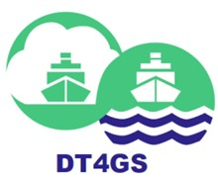
DT4GS
Project overview
LMDE | June 21-23 | Syros, Greece
Dimitrios Kaklis (Danaos Research Centre)
This project has received funding from the Horizon Europe framework programme under Grant Agreement No 101056799

Slide 2
Project Facts
Project title: The Digital Twin for Green Shipping
GA Νo: 101056799
Start date 1st June 2022
Duration: 3 years
Consortium: 21 partners
Coordinator: Inlecom Group
Website: https://dt4gs.eu/
This project has received funding from the Horizon Europe framework programme under Grant Agreement No 101056799

Slide 3
DT4GS Objectives
DT4GS is aimed at making Digital Twin technology readily available to the shipping industry to support accelerated transition to zero emissions
Open Ship Operational Optimization Digital Twining Infrastructure (industry–ready by June 2024) built on top of a Waterborne Sector Data Space to support shipping companies:
build their own ship specific DTs focusing on voyage optimization (speed, trim, route/JIT arrival/ vessel health)
quantifying the effect of the different decarbonization pathways on the vessel emission profile, technical and economic
A Multi-stakeholder green shipping transition methodology underpinning a collective DT capability for the waterborne industry to harmonize and increase synergies between DT applications in shipping companies, shipyards, equipment manufacturers, class societies, ports, and policy makers
This project has received funding from the Horizon Europe framework programme under Grant Agreement No 101056799

Slide 4
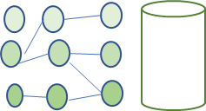
DT4GS Methodology
4 Living Labs
LL1 EURONAV Tanker centric DT; LL2 DANAOS Container centric DT; LL3 Baleària ROPAX centric DT;
LL4 STARBULK Bulk centric DT; LL5 Extended industry LL from month 16
Open DT4GS Infrastructure Development and Deployment tools
DT4GS Applications
Ship Operational Optimisation [Εnvironmental and Economic KPIs]
Open DT modelling and simulation environment set-up AI Tools and Big Data Analytics Infrastructure (BDA) Virtual Model Execution Engine
Graph Repository
Business Glossary Ontology
DT4GS Model Blueprints and Open Model Library
Data sources
Metadata
Connectors Data Governance DT4GS (Green Shipping) Dataspace
Ship Subsystems
Hull, Machinery, Energy
Voyage Operational Controls
Speed Trim Route/JIT optimisation - Voyage costs
Short Term KPIs
20% reduction in CO2e 2026 horizon
DT Tuning
Decarbonisation Solutions (DS) intelligent ‘assistant’ that supports the evaluation, selection and deployment of DSs
Carbon capture
Energy Recovery HVAC
Green Fuels
Hydrodynamic enhancements
Wind assist
Medium Term KPIs
55% reduced CO2e by 2030
New multi - stakeholder Green Ship Design Construction and Operation
Long Term KPIs
Zero emission shipping
2050 horizon
DT4GS Headquarters, Edge and Orchestration Infrastructure
The DT4GS Modelling Framework - Multi-stakeholder green shipping Transition methodology
This project has received funding from the Horizon Europe framework programme under Grant Agreement No 101056799
Notes:
DT4GS is an “Open Digital Twining Framework for Green Shipping” providing a comprehensive digital representation of ships (DT4GS Open Models Library) and standard Connectors to ship and shipping data sources enabling data-driven decision making for sustainable, low-emissions, high-efficiency ship operations.
The proposed methodology highlights the following:
the Open DT4GS Infrastructure Development and Deployment tools including semantic gateways to facilitate interaction with external platforms and applications. In addition, provide tools for tuning a ship (Digital Twin) control model enabling ship specific operational optimisation coupled with decarbonisation transition management
Provide reference DT4GS Applications architectures and components, further facilitating development of green shipping DTs for:
Ship Operational Optimisation against specific environmental and economic KPIs
evaluation, selection and deployment of Decarbonisation Solutions (DS) for individual ships targeting 55% reduced CO_{2e} by 2030 (Intelligent DS Assistant)
multi-stakeholder Green Ship Design Construction and Operation.
Deploy and validate DTs in 4 Living Labs for different ship types
LL1 EURONAV Tanker centric DT;
LL2 DANAOS Container centric DT;
LL3 Baleària ROPAX centric DT;
LL4 STARBULK Bulk centric DT;
LL5 Extended industry LL
‹#›

Slide 5
Approach
Company - centric Confidentiality preserving DT
Improved decisions - Optimisation [operation, retrofitting, new builds]
DT4GS Open Digital Twin Framework
Support
Improved decisions
Low-emission shipping Virtual Testbed and Decision Support System
(retrofit / new build)
Configuration Updates
Modeling and simulation
Analytics and AI tools
Interventions Control
Reporting
DT4GS Data Space Connectors
Common DT Dataspace
DT4GS Modelling Framework and Reference Models and Blueprints Directory
Ship in Physical world
Data
Asset/ System Monitoring
Ship Digital Twin
EDGE
This project has received funding from the Horizon Europe framework programme under Grant Agreement No 101056799
Notes:
The DT4GS Open Digital Twin Framework will enable ship operators and other industry stakeholders to set up their own DTs based on their own models and data and build their own confidential data-driven decision-making systems for low-emissions, high-efficiency ship / fleet operations, at reasonable cost.
‹#›

Slide 6
Breaking down the approach
Open DT Framework
Open to everyone generic DT4GS platform Tier 1 (Community version and free to use)
Company Specific DT
Based on the Open DT Framework
Customized by the company for its specific needs
Collects data from the Ship Specific DTs in order to optimize the company’s operation
Feeds non confidential data to DT4GS Dataspace
Ship Specific DT
Based on the Open DT Framework
Customized by the company for each ship
Collects data from various sources (machinery, weather, etc.) to optimize the ship’s operation
Feeds data back to the company’s DT
Feeds non confidential data to DT4GS Dataspace
Company Specific DT
Open DT Framework
Ship Specific DT
This project has received funding from the Horizon Europe framework programme under Grant Agreement No 101056799

Slide 7
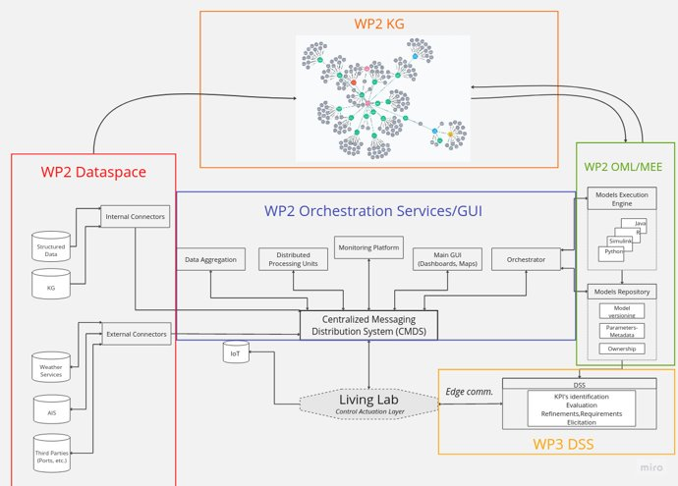
Key Achievements: DT4GS Arch Definition

Slide 8
Key Achievements: Automated Administrative
workflows

Slide 9
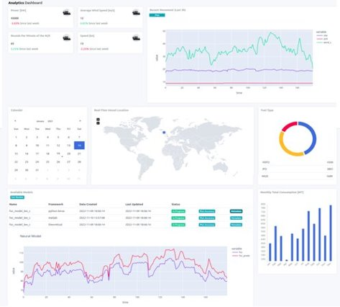
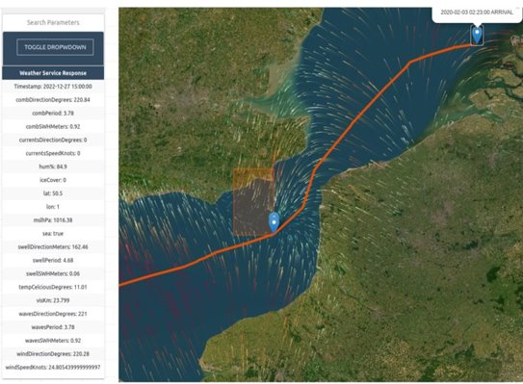
Key Achievements: Digital Twin(ing) Operational Opt. suite

Slide 10
Project ship/fleet performance optimisation targets
Optimisation areas | Navigation Management | Integrated Machinery performance management and remote control | Integrated ship energy production, distribution, recovery & management | Digital Twin for the Ship Hull and loading | JIT arrivals | Life Cycle Assessment Management
Efficiency improvement | 3-8% | 3-8% | 5-15% | 3-10% | 3-10%
Average CO2e Reduction | 5% | 5% | 10% | 5% | 5% | 5%
Average ship CO2e reduction 15% to be verified by measurements from the LLs
This project has received funding from the Horizon Europe framework programme under Grant Agreement No 101056799

Slide 11
Thank you for your attention!
Dimitrios Kaklis (Danaos Research Centre)
info@dt4gs.eu / dk.drc@danaos.gr
https://dt4gs.eu/
https://www.linkedin.com/showcase/dt4gs/
This project has received funding from the Horizon Europe framework programme under Grant Agreement No 101056799

